Slide 1
Multi Tool CNC Station
A project by~
Akshay Ganpat kurhade be a
Onkar sunil tanwade be a
Prachi Prakash gore be a

Slide 2
What is CNC?
Computer numerical control (CNC) is the automation of machine tools by means of computers executing pre-programmed sequences of machine control commands. This is in contrast to machines that are manually controlled by hand wheels or levers, or mechanically automated by cams alone.
In modern CNC systems, the design of a mechanical part and its manufacturing program is highly automated. The part's mechanical dimensions are defined using computer-aided design (CAD) software, and then translated into manufacturing directives by computer-aided manufacturing (CAM) software. The resulting directives are transformed into the specific commands necessary for a particular machine to produce the component, and then loaded into the CNC machine.

Slide 3
Abstract
Traditionally all CNC stations have been standalone systems i.e. a different setup for every specific operation(milling, drilling, extrusion, etc.)
Its becoming an increasing need to develop integrated systems that can do multitasking. This is needed primarily due to two major reasons.
Space constraints, CNC setups usually take up a huge space for single machining setup. Multiple machining processes require a huge space which becomes impossible for small manufacturing units or educational setups to afford.
Cost constraints, Individual CNC setups cost a huge sum of money for different setups for every single operation. For example, a milling setup requires around a INR 1 lakh setup, a drilling setup the same amount, the 3d extrusion setup similar amount. Thus making it a huge sum.
These constraints make the traditional systems unusable for prototyping stages, where it is actually required but is unaffordable .

Slide 4
Problem Statement
Developing an integrated CNC system that can do multiple CNC operations on a single machining setup with minimum re-configuration.

Slide 5
Need of CNC
The traditional manufacturing involves skilled labor which puts in the human factor in picture. Which leads to uncontrollable errors. The new manufacturing industry requires accurate results. Also it requires the machine to produce the same results each time.
CNC uses numerically calculated commands and positions along with a reliable mechanism to implement it.
Also the traditional machining equipment's cannot be used 24*7 for 365 days, on the other hand a CNC setup can be run all the time with no or minimum maintenance period

Slide 6
Why a multitool setup?
Prototyping any product requires multiple machining processes which primarily involve 3d printing, milling, laser cutting, etc.
Prototyping may need fine tuning and getting this work done using industrial shops can get expensive as well as tiresome.
Also basically all CNC setups can share the same 3-axis (cartesian) setup which can save time, money as well as resources.
No need to program different setups, which may involve getting knowledge of each machine separately.
Compactness

Slide 7
Block Diagram
Laser Engraver
3d printer
(hotend and extruder)
3- axis frame
(stepper motors and working bed)
Interchangeable
Computer
Milling spindle
To Local Network
Router
Controller
(Atmega2560)
MEMORY
Raspberry Pi
LCD controller

Slide 8
Proposed setup
The proposed setup will contain easily interchangeable tool heads which include
A 3d printing head
A milling head
A heated bed setup for 3d printing
An wooden working base for milling
Single controller board(based on Atmega 2560)
LCD controller board for in system manual tweaking
A 3-axis(cartesian) i.e. X,Y,Z axis frame controlled using stepper motors

Slide 9
Working
Working of the setup can be divided into two separate blocks depending on the tool head used.
The basic working is based on deciding the exact position of the toolhead by calculating its cartesian(x, y, z) co-ordinates using a cam software.
Stepper motors along with a tooth-belt pulley arrangement give an accurate displacement.

Slide 10
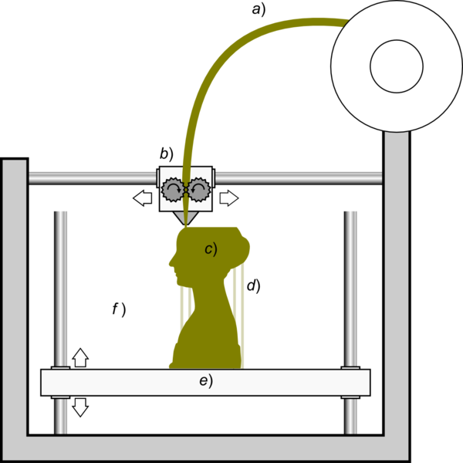
3d printing working
The 3d printer toolhead works on the Fused Deposition Modelling(FDM) principle.
What is FDM?
FDM works on an "additive" principle by laying down material in layers i.e. a plastic filament or metal wire is unwound from a coil and supplies material to produce a part.
Materials used in FDM 3d printing
PLA(Poly Lactic Acid)
ABS (Acrylonitrile butadiene styrene)

Slide 11
..continued
Steps involved in FDM-
FDM begins with a software process which processes an STL file (stereolithography file format), mathematically slicing and orienting the model for the build process.
A plastic filament or metal wire is unwound from a coil and supplies material to an extrusion nozzle which can turn the flow on and off.
The nozzle is heated to melt the material
The nozzle follows a tool-path controlled by a computer-aided manufacturing (CAM) software package, and the part is built from the bottom up, one layer at a time.

Slide 12
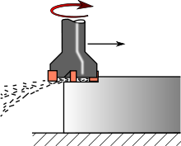
3-axis CNC milling
Milling is a cutting process that uses a milling cutter to remove material from the surface of a workpiece. The milling cutter is a rotary cutting tool.
The milling process removes material by performing many separate, small cuts. This is accomplished by using a cutter with many teeth, spinning the cutter at high speed.
We use a vertical mill arrangement.
In the vertical mill the spindle axis is vertically oriented. Milling cutters are held in the spindle and rotate on its axis.
Here in the proposed system the milling bed is stationary while the spindle rotates on the axes.

Slide 13
References
“Development of an integrated system of 3D printer and laser carving” by Cheng-Tiao Hsieh, Published in Microsystems, Packaging, Assembly and Circuits Technology Conference (IMPACT), 2016 11th International, 10.1109/IMPACT.2016.7800062
E. Canessa, C. Fonda, and M. Zennaro, “Low-cost 3D Printing for Science, Education and Sustainable Development”, International Centre for Theoretical Physics, 2013
“THE THIRD DIMENSION OF PRINTING TECHNOLOGY USING 3DIMENTIONAL MODEL”, by Dr. Bobby Lukose International Journal of Innovations in Scientific and Engineering Research(IJISER), ISSN:2347-971X, July 2016

